Slide 1
UNIVERSITY OF BUEA
Faculty of Engineering and Technology
CEF440 - INTERNET PROGRAMMING AND MOBILE PROGRAMMING
TASK 4: SYSTEM MODELLING AND DESIGN
GROUP 16
Course Instructor: Dr. Nkemeni Valery

Slide 2
AGENDA
1
I
II
Introduction
Context Diagram
III
IV
Data Flow Diagram
Use Case Diagram
V
VI
Sequence Diagram
Class Diagram
VII
Deployment Diagram
2

Slide 3
I. INTRODUCTION
2
System Modeling
System Design
Uses UML graphical notations to document a system from multiple perspectives
External: models system environment & context
Interaction: shows component communication (Sequence Diagrams)
Structural: depicts static organization (Class Diagrams)
Behavioral: illustrates dynamic state changes
Translates models into a concrete architecture
High-Level Design (HLD): overall architecture, major modules & services
Low-Level Design (LLD): detailed logic, algorithms, data structures
Key Pillars: scalability, reliability, availability, and performance
3

Slide 4
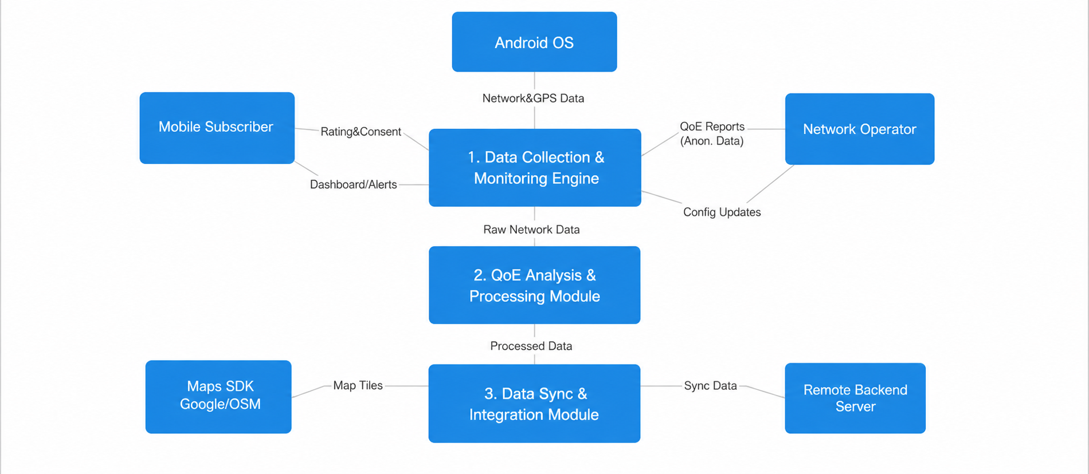
II. CONTEXT DIAGRAM
3
The QoE Monitoring App acts as the central system that collects, processes, and exchanges network quality information with different entities.

Slide 5
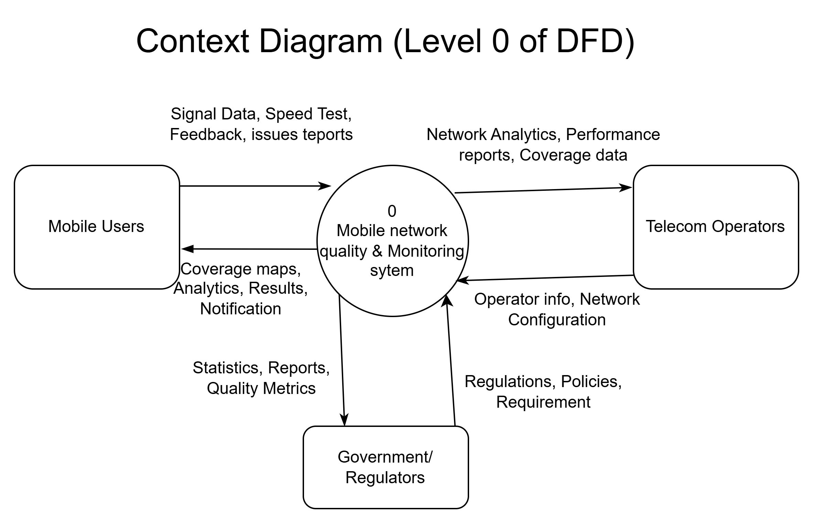
III. DATA FLOW DIAGRAM — LEVEL 0
4
A Data Flow Diagram (DFD) is a visual map that illustrates how information moves through a system or business process. It shows where data originates (inputs), how it is processed and transformed, where it is stored, and where it ultimately exits (outputs).
6

Slide 6
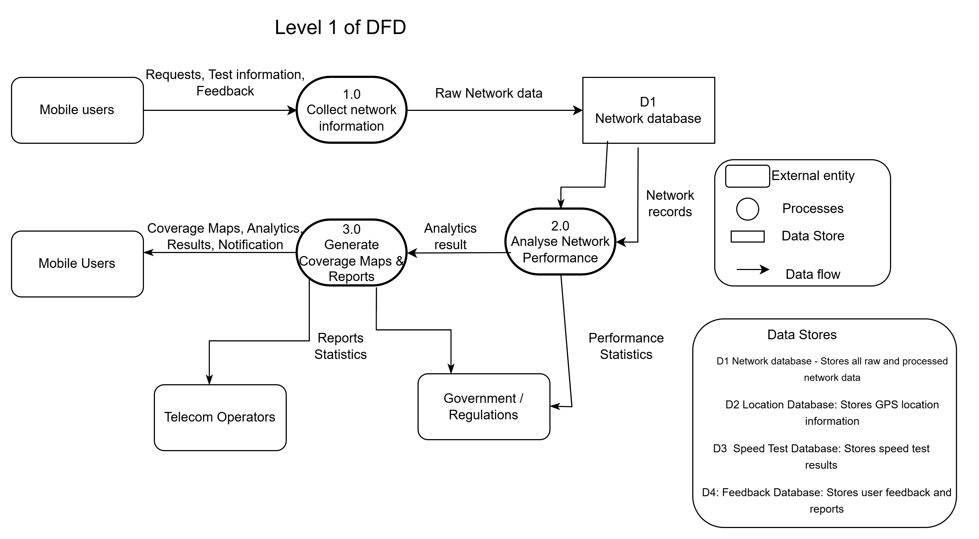
DATA FLOW DIAGRAM — LEVEL 1
5

Slide 7
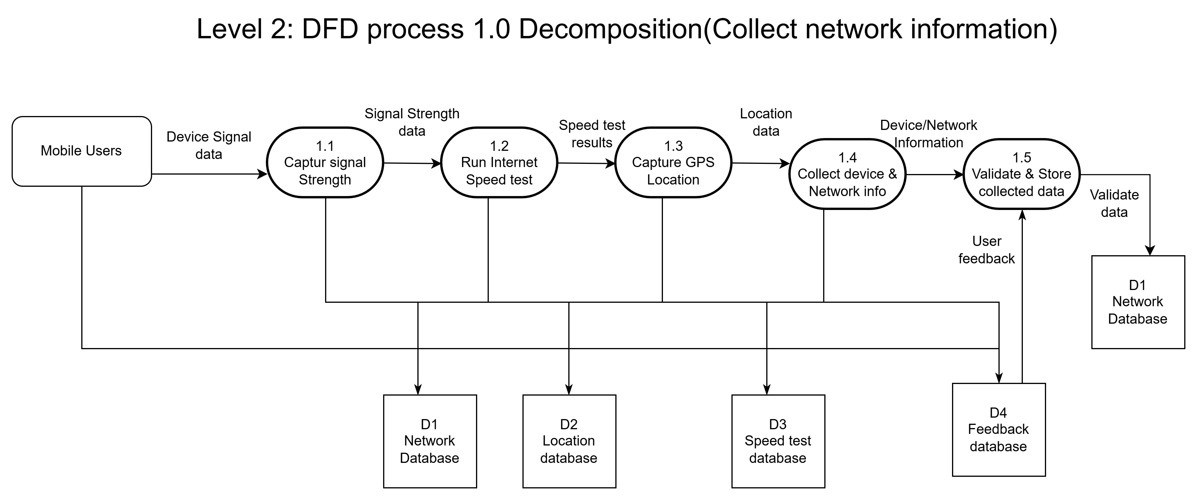
DATA FLOW DIAGRAM — LEVEL 2
6

Slide 8
IV. USE CASE DIAGRAM
7
Actors
Use Cases
Use Case Diagram
In a use case diagram, actors represent the external roles that interact with a system. They define who or what is using the system, establishing clear boundaries between what is inside the software and its environment.
A use case is a written or visual scenario describing how a user interacts with a product or system to achieve a specific goal.
A Use Case Diagram is a visual way to show how users (actors) interact with a system and what functions (use cases) the system provides. It helps understand the system’s behavior from the user’s perspective.
8

Slide 9
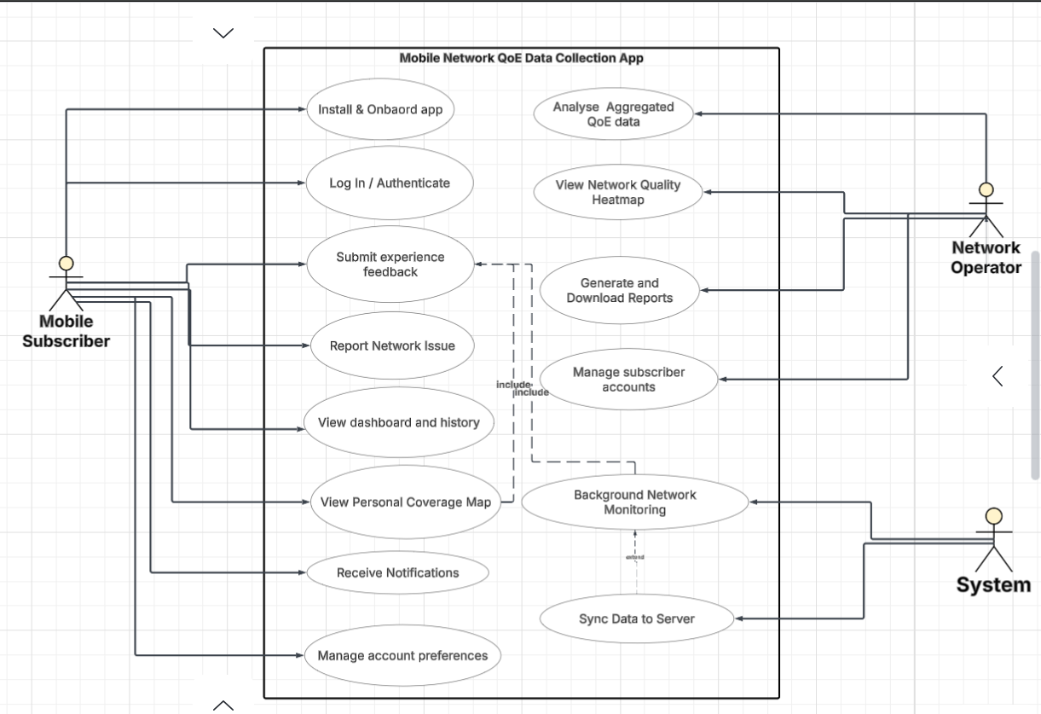
USE CASE DIAGRAM
8

Slide 10
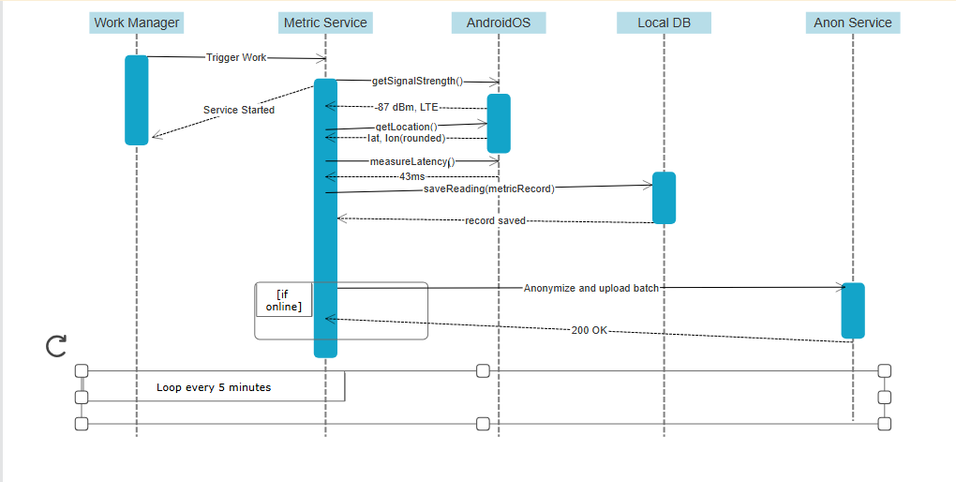
V. SEQUENCE DIAGRAM
9
A sequence diagram is a visual tool used in software engineering and system design to show how different parts of a system interact with each other to complete a task.
Notes:
A sequence diagram is a visual tool used in software engineering and system design to show how different parts of a system interact with each other to complete a task. It maps out the exact chronological order in which messages, requests, and data are passed between objects.

Slide 11
VI. CLASS DIAGRAM
10
A class diagram is a visual representation of an object-oriented system's structure. Widely used in software engineering, it maps out the system's classes, their data (attributes), behaviors (methods), and the connections between them to serve as a blueprint for coding.
Key Classes
Key Relationships
NetworkReading
MonitoringService
NetworkMetricCollector
LocationManager
AnomalyDetector
Aggregation between MonitoringService and NetworkReading
Association between UserFeedback and NetworkReading
Dependency between NetworkMetricCollector and NetworkReading

Slide 12
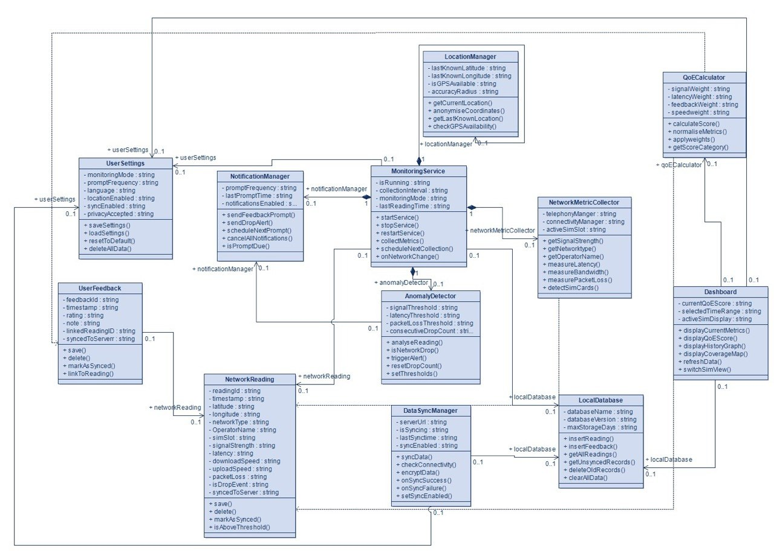
CLASS DIAGRAM
11

Slide 13
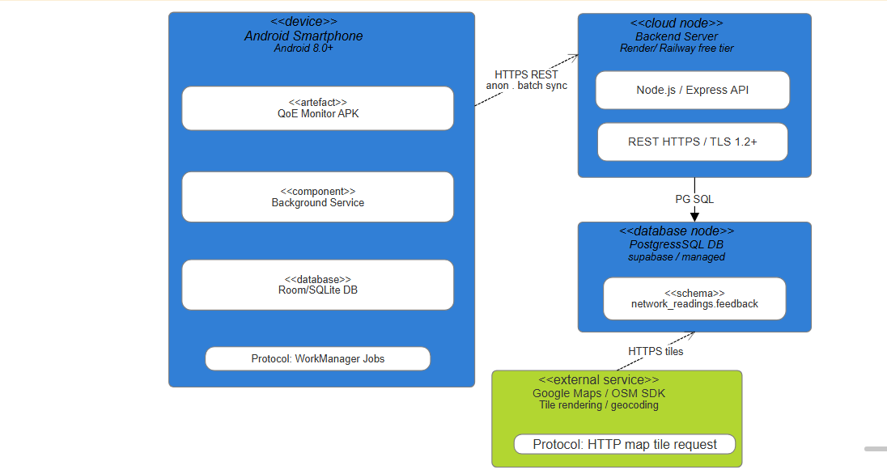
VII. DEPLOYMENT DIAGRAM
12
A deployment diagram is a structural UML diagram that visualizes the physical hardware and software architecture of a system. It shows how software components and data (artifacts) are mapped onto physical or virtual infrastructure (nodes) and how they communicate.

Slide 14
13
CONCLUSION
Robust Blueprint
Translates high-level requirements into detailed DFDs, UML, and architecture diagrams ensuring scalable, fault-tolerant data pipelines.
Modular Architecture
Each class has a single clear responsibility; composition, aggregation, and dependency relationships minimise coupling.
WHAT'S NEXT
Task 5
UI DESIGN AND IMPLEMENTATION

